Slide 1
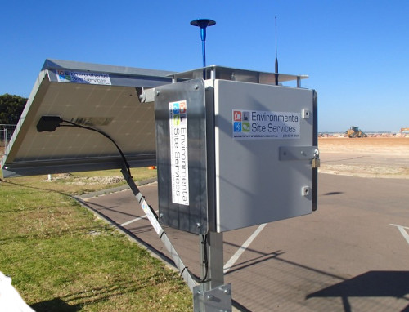






Key Technologies
Air Quality Analysis of Odisha (2015)
PySpark
Seaborn
Data Visualization
Dataset
Project using PySpark and Seaborn
CPCB Odisha 2015
2392 records
By: L. Guna Vardhan Reddy
12 columns

Slide 2





Project Overview
Objective
Analyze Odisha's air quality data for 2015
Analysis Tools
Dataset Source
CPCB (Central Pollution Control Board)
2392
12
Data Size
PySpark
Seaborn
Records
Columns
2392 records, 12 columns

Slide 3




Problem Statement
Health Risks
Rising air pollution levels pose significant health risks to urban populations
Data Analysis Need
Identify pollution hotspots through systematic data analysis
Research Goal
Discover patterns, correlations, and trends across cities and pollutants
Urban Air Pollution
Industrial emissions affecting air quality in urban areas

Slide 4









Dataset Description
Dataset Columns
SO2
NO2
PM10
PM2_5
State
City_Area
Type of Location
Agency
Sampling Date
Data Structure Overview
Data Types
Pollutants
Location
Classification
SO2, NO2, PM10, PM2_5
State, City_Area
Type of Location
Numerical: SO2, NO2, PM10, PM2_5
Categorical: State, City_Area, Type of Location, Agency
Date: Sampling Date
Source
Time
Size
Agency
Sampling Date
2392 records
Coverage
Multiple cities across Odisha state

Slide 5





Data Cleaning
1
Remove Invalid Data
Data Cleaning Pipeline
Dropped null and duplicate rows
Filter - Remove invalid records
2
Remove Unnecessary Columns
Deleted column: Unnamed: 11
Delete - Remove unnecessary columns
3
Rename Complex Columns
PM 2.5 → PM2_5, RSPM/PM10 → PM10
Rename - Simplify column names
4
Handle Missing Values
Applied mean imputation for missing PM2_5 values
Impute - Fill missing values
5
Convert Data Types
Transformed Sampling Date to proper DateType
Transform - Convert data types

Slide 6









PySpark Preprocessing Pipeline
Data Preprocessing
Raw Data - Mixed categorical and numerical features
Categorical Encoding
Used StringIndexer for categorical columns
StringIndexer - Convert categorical to numerical
Feature Assembly
VectorAssembler - Combine features into vectors
Applied VectorAssembler for numeric features
Feature Scaling
StandardScaler - Normalize feature values
Implemented StandardScaler for normalization
Pipeline Automation
Processed Data - Ready for analysis
Built preprocessing Pipeline for reproducibility
pipeline = Pipeline(stages=[ stringIndexer, vectorAssembler, standardScaler ])

Slide 7
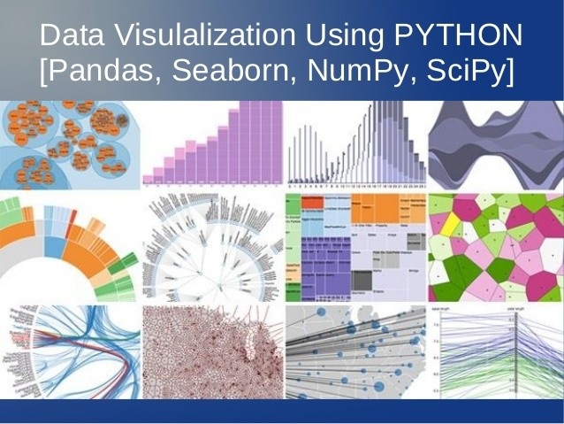













Visualization Tools
Data Conversion
Spark DataFrame
Pandas DataFrame
Visualization Libraries
Seaborn
Matplotlib
Plot Types Created
Heatmap
Boxplot
Histogram
Line plot
City-wise barplot

Slide 8








Key Findings
PM Correlation
Pollution Hotspots
PM10 and PM2.5 show strong correlation
Industrial areas show highest pollution
0.8
Talcher
Angul
Low
High
Gaseous Pollutants
PM Levels
SO2 and NO2 mostly within limits
PM levels exceed CPCB standards
Within CPCB standards
Multiple zones affected

Slide 9
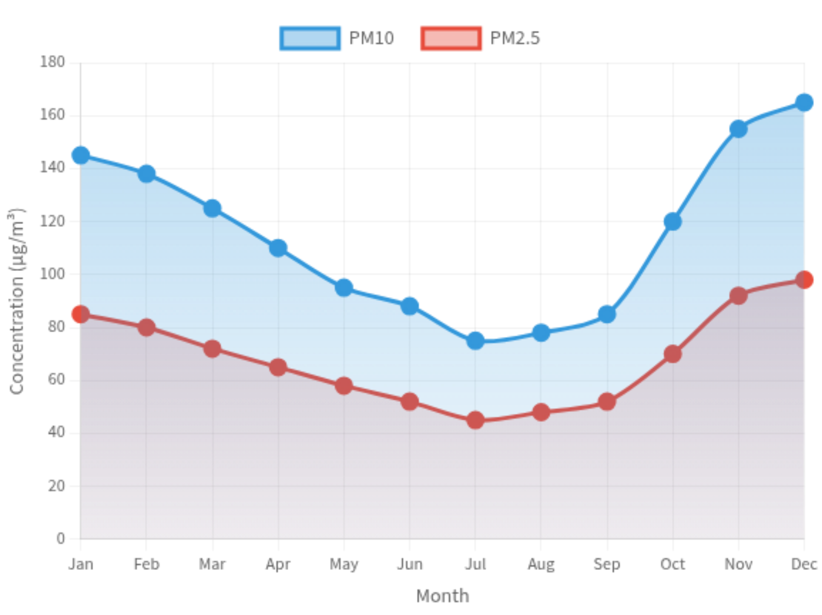


Trend Analysis
PM10 & PM2.5 Monthly Trends (2015)
Seasonal Peaks
Pollution peaks during winter months
Industrial Zones
Consistent high PM levels in industrial areas
Increasing Trends
Line plots show rising PM10/PM2_5 over time
Winter (Oct-Feb)
Summer (Mar-Jun)
Monsoon (Jul-Sep)

Slide 10











Conclusions
Air Quality Status
Technology Impact
Poor air quality in industrial regions
Efficient analysis with PySpark
PM10 & PM2.5 exceed safe limits
Clear insights via Seaborn
Pollution Risk
High
PySpark
Seaborn
Data Visualization
Key Insights
Environmental Impact
Strong PM10-PM2.5 correlation
Supports data-driven decisions
Industrial zones as pollution hotspots
Enables targeted interventions
Seasonal winter peaks in pollution
Decision Value
High

Slide 11









Future Scope
Real-time Analysis
ML Integration
Implement live monitoring systems
Develop AQI prediction models
Spark Streaming
Kafka
Enable early warnings for pollution spikes
Implementation
Medium
Implementation
High
Geo-mapping
Extended Analysis
Create interactive maps of pollution
Analyze multi-year datasets
Folium
Plotly
Identify long-term trends
Implementation
Low
Implementation
Low

Slide 12





References & Thank You
Thank You
L. Guna Vardhan Reddy
References
CPCB Official Data Portal
PySpark Documentation
Seaborn and Matplotlib Libraries

